Slide 1

Flight Data Analysis

Slide 2
Personal Information
Name :
Sachin Bhardwaj.
Email ID :
sachin.19jan@gmail.com
Experience :
7 years
Technology:
Sr. IOS Developer
Organisation: Mobile No:
Publicis Sapient, GGN +91-9540373354

Slide 3
Introduction
The project includes analysis of the Flight Data set depending on departure delay, arrival delay, speed of the aircraft, maximum number of flights headed to the particular destination.
Steps followed to do analysis on Data are :
Find out dependent and independent variables
Drop Independent variables from dataset
Fill the NA values
Box plot to identify outliers
Zscore to remove outliers

Slide 4
Dataset Description
Pandas Profiling : pandas_profiling that helps one in automating the first-level of EDA.
For each column the following statistics - if relevant for the column type - are presented in an interactive HTML report:
Essentials: type, unique values, missing values
Quantile statistics like minimum value, Q1, median, Q3, maximum, range, interquartile range
Descriptive statistics like mean, mode, standard deviation, sum, median absolute deviation, coefficient of variation, kurtosis, skewness
Most frequent values
Histogram
Correlations highlighting of highly correlated variables, Spearman and Pearson matrixes

Slide 5
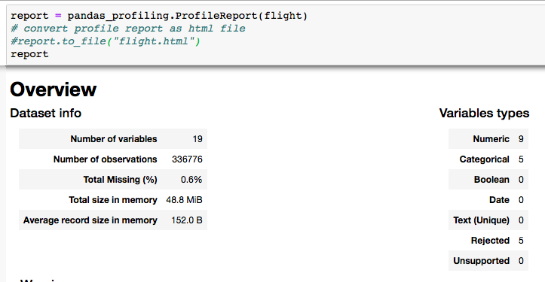
Description of flight data
Overview

Slide 6
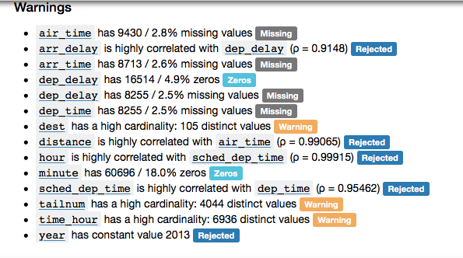
Warnings in Dataset
We have removed highly correlated and constant values those are not required from the dataset to get more correct result
flight.drop(['year','hour','minute','sched_dep_time', 'sched_arr_time'], axis=1, inplace=True)

Slide 7
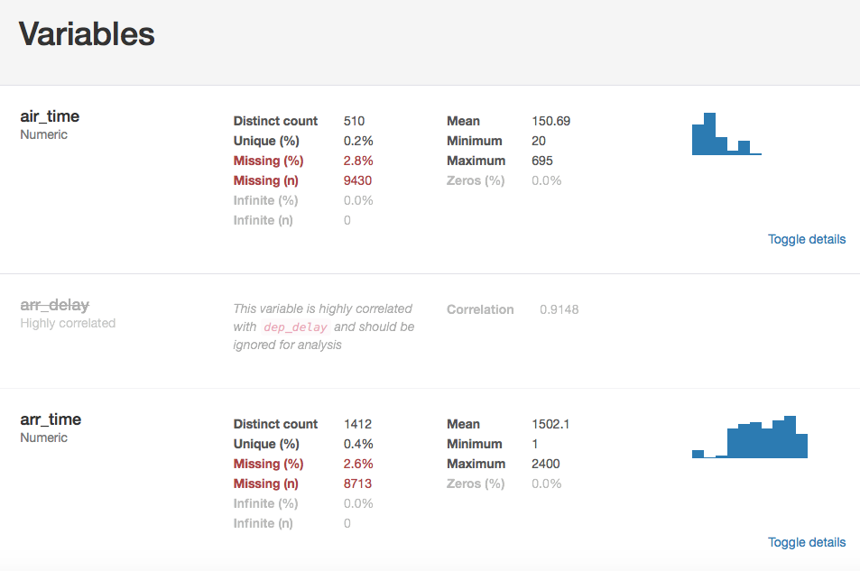
Missing Value Analysis

Slide 8
Cleaning Data Set
Data cleansing or data cleaning is the process of identifying and removing (or correcting) inaccurate records from a dataset, table, or database and refers to recognising unfinished, unreliable, inaccurate or non-relevant parts of the data and then restoring, remodelling, or removing the dirty or crude data.
Following are the steps for data cleaning
Remove dependent variables. Query to remove dependent variable
flight.drop(['year','hour','minute','sched_dep_time', 'sched_arr_time'], axis=1, inplace=True)

Slide 9
2. fill NA values.
# fill null values with mode
cols = ['dep_delay','arr_time','tailnum','arr_delay','dep_time']
flight[cols]=flight[cols].fillna(flight.mode().iloc[0]) #Create dataset of only categorical values flight_categorical_data = flight[['carrier','tailnum','origin', ‘dest']]

Slide 10
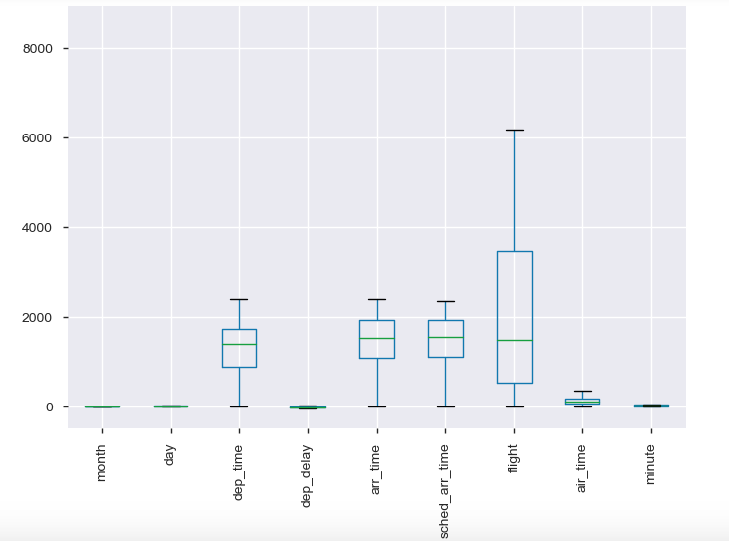
3 Box Plot to identify outliers
#Command to draw box plot
flight.boxplot()
plt.xticks(rotation=90)
plt.show()

Slide 11
Business Questions Identified
Q1. In Which Month flights are more demanding? (Peak time of flight)
Approach: Outlier treatments
floring and coupling (1 % to 99 %) approach for Outlier treatment
Zscore
IQR

Slide 12
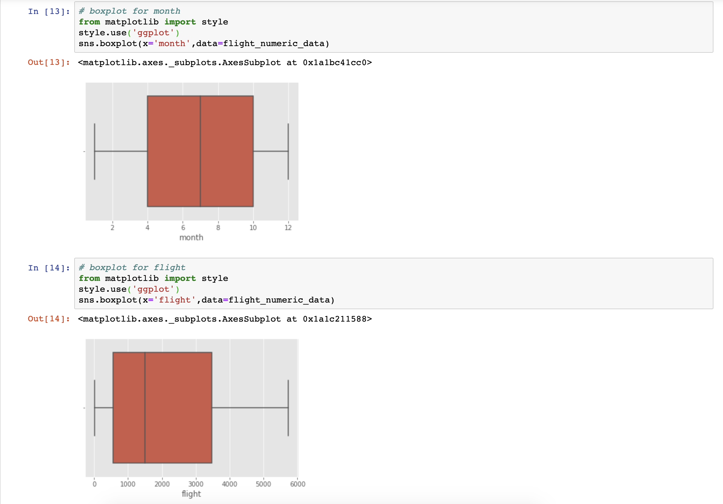
Boxplot after Outlier treatment

Slide 13
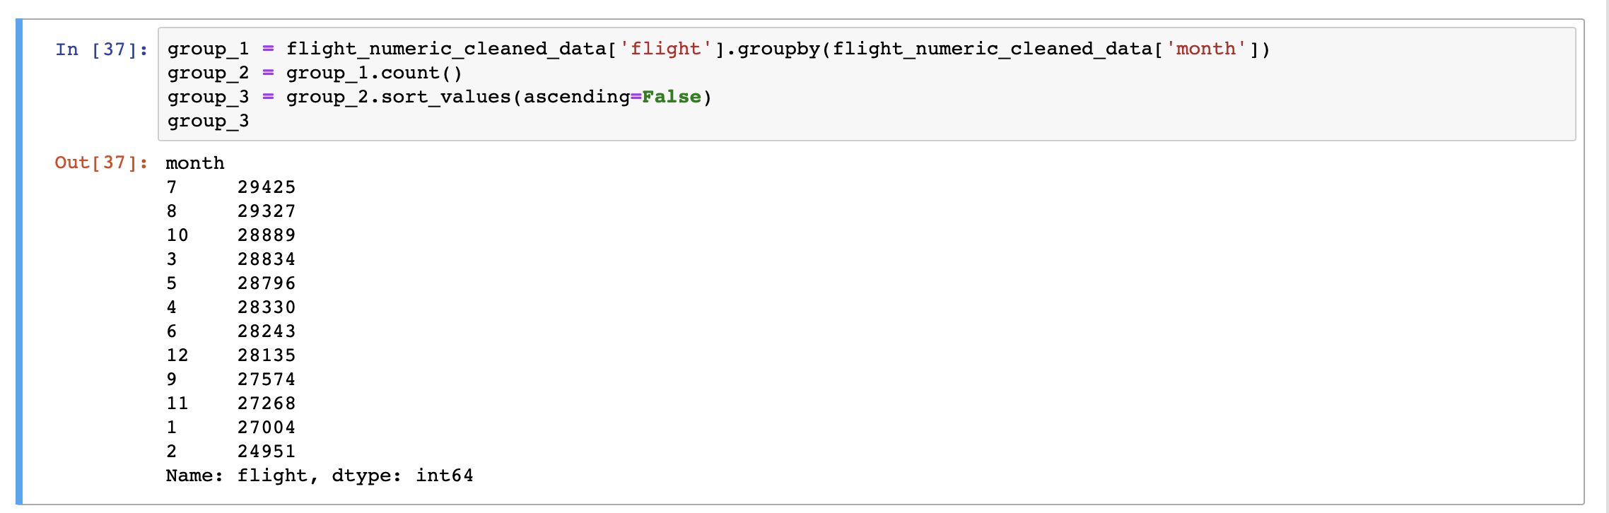
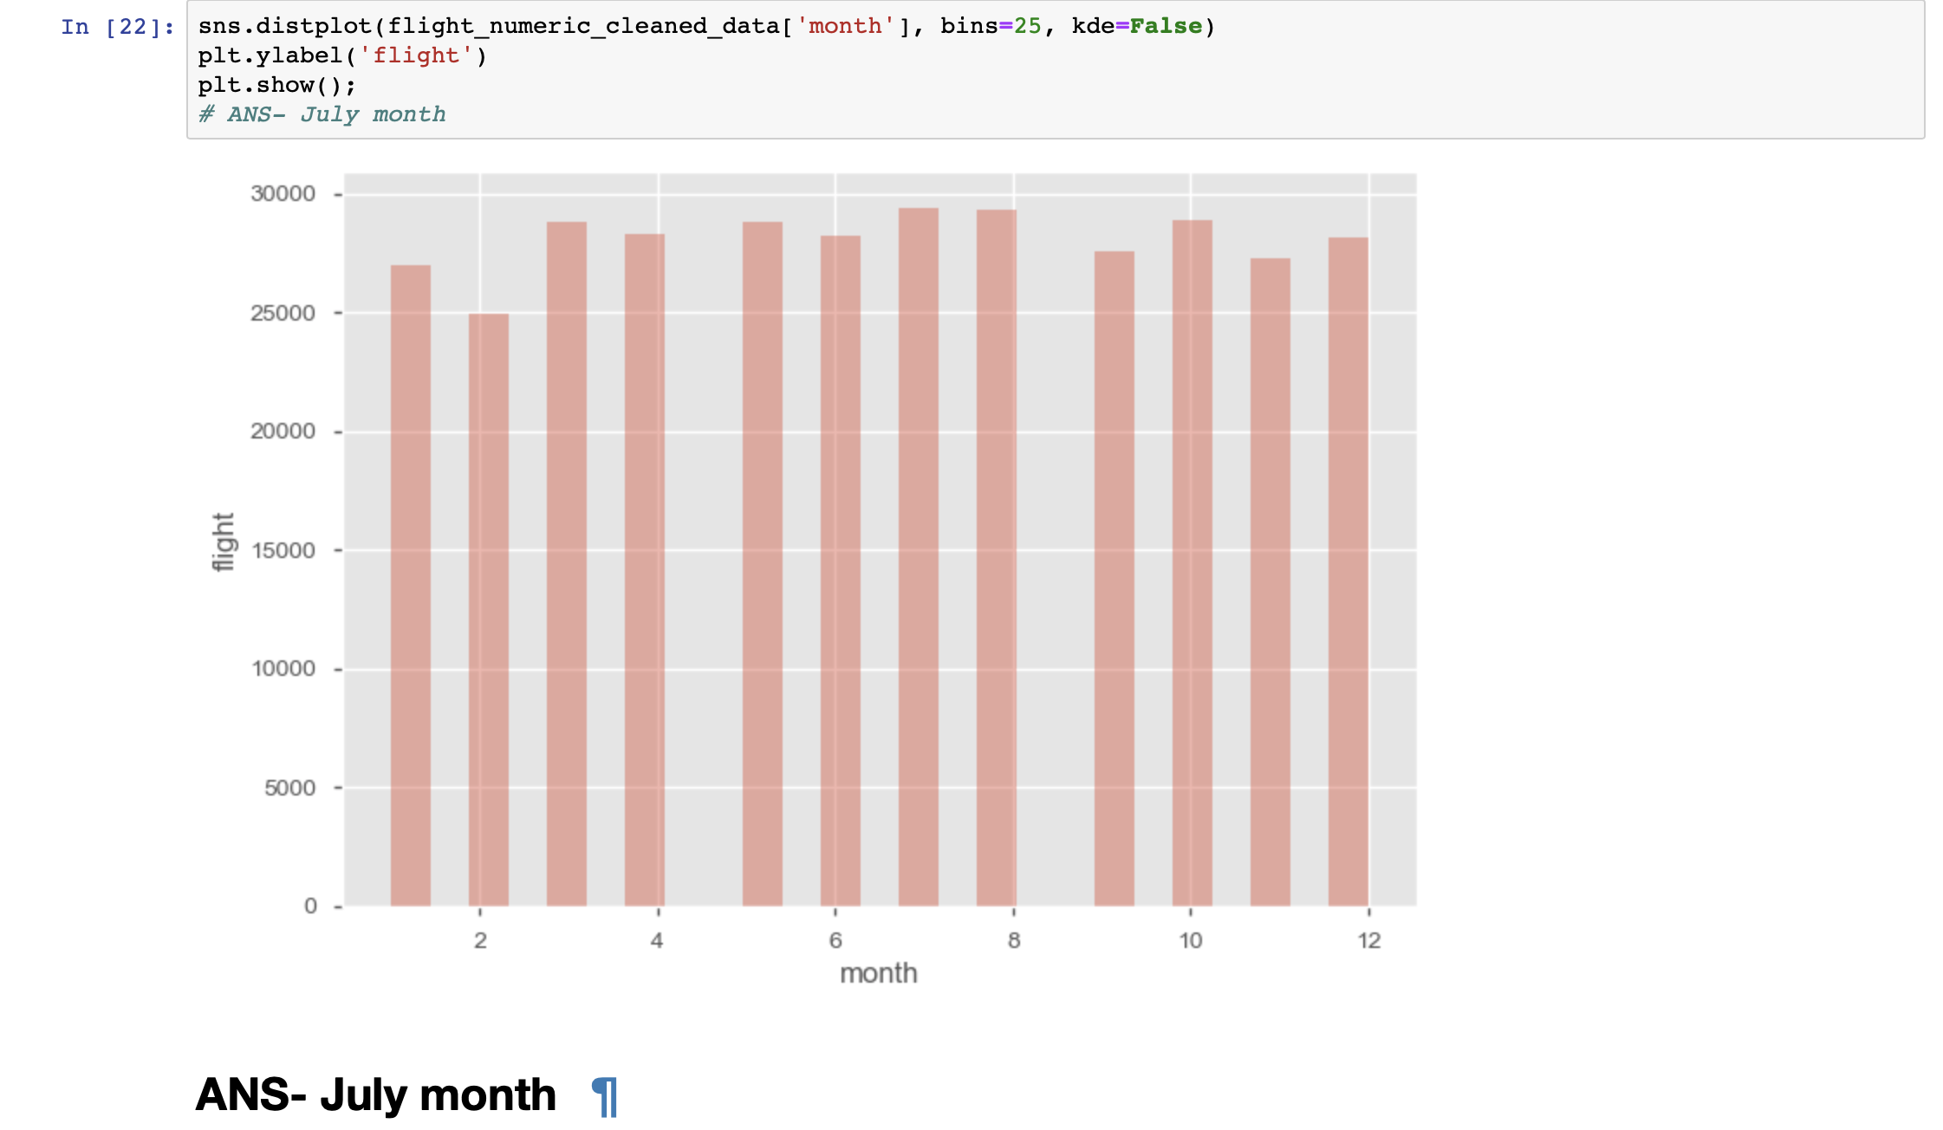
Findings & Visualizations

Slide 14
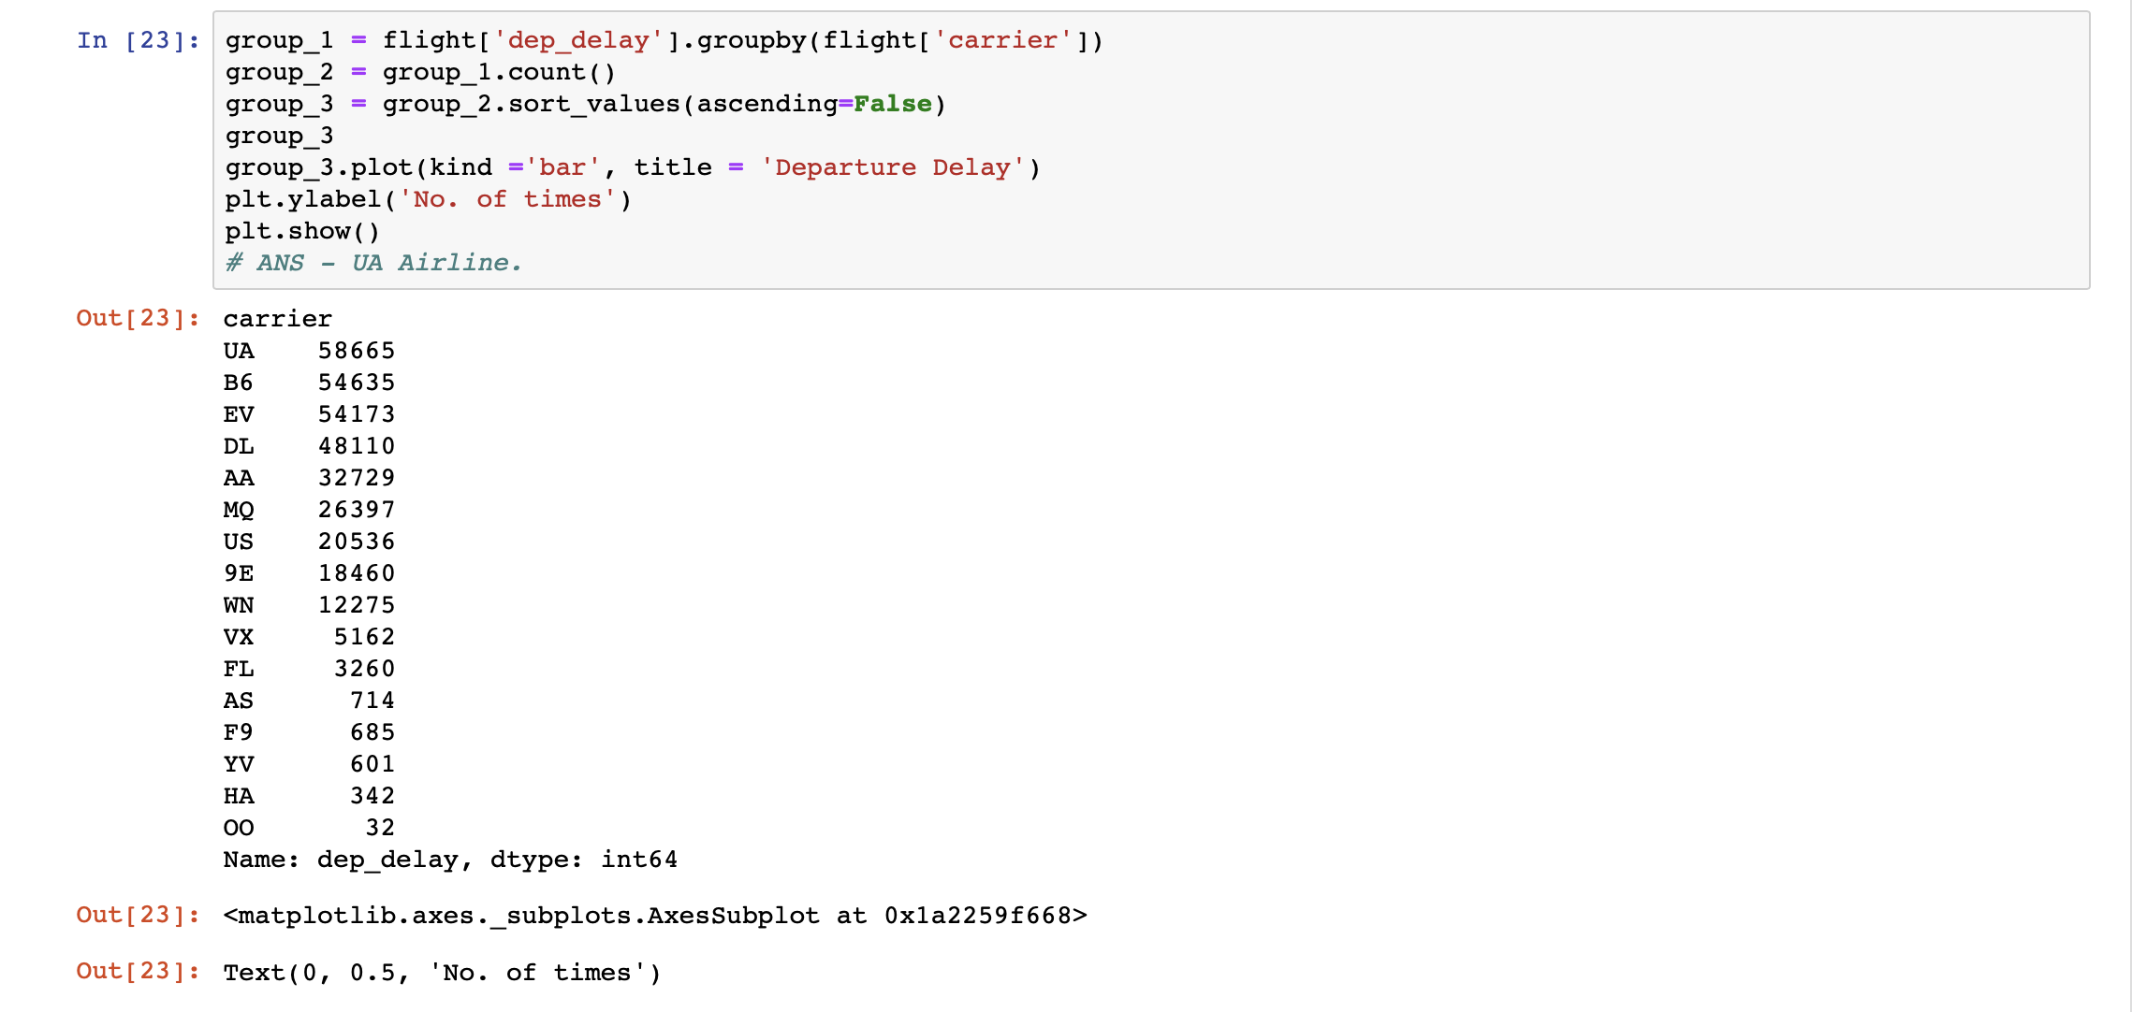
Q2 - Which Airline maximum Departure delays. (Number of times)
Findings & Visualizations

Slide 15
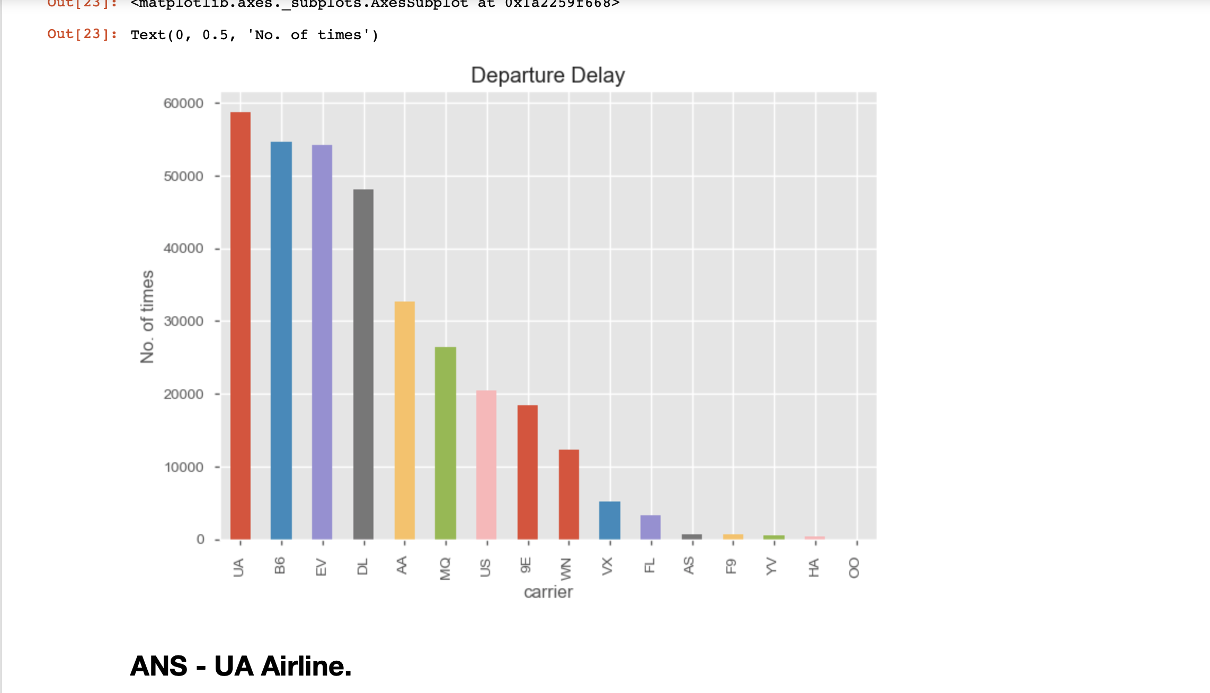
Findings & Visualizations

Slide 16
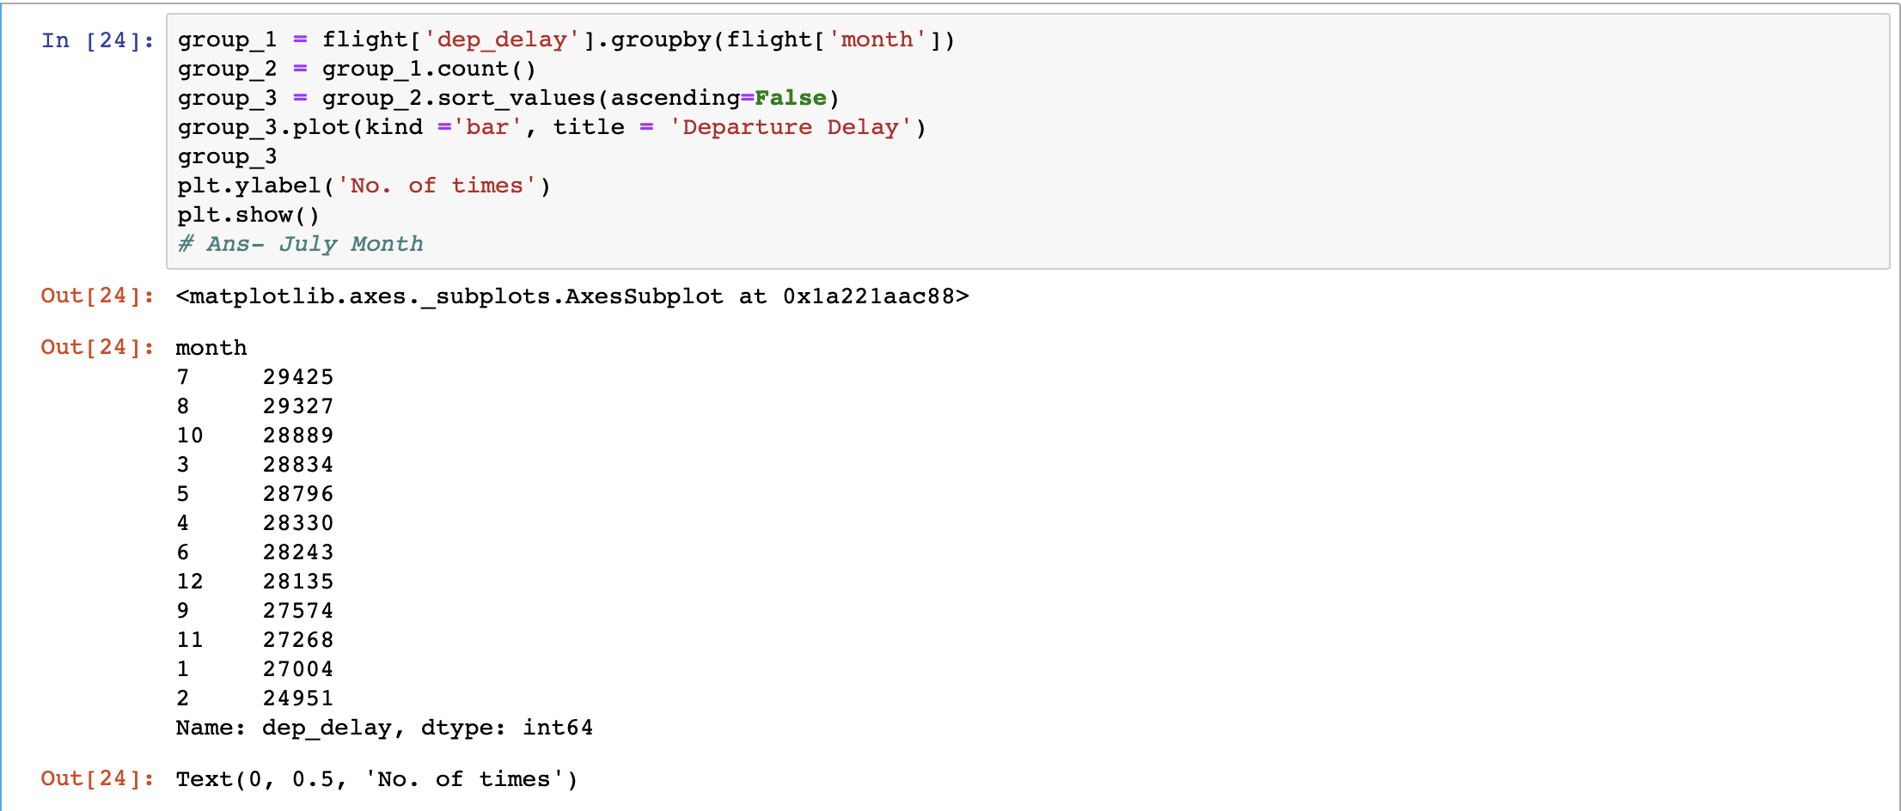
Q3 - In which month maximum Departure delays occurred.
Findings & Visualizations

Slide 17
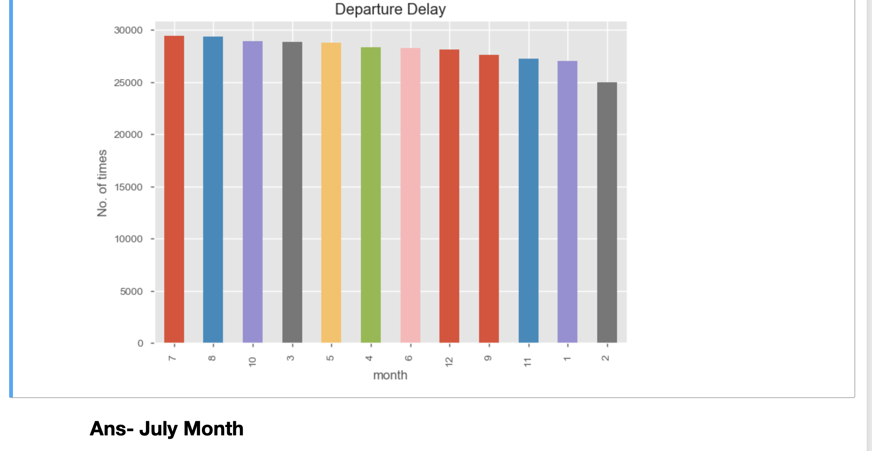
Findings & Visualizations

Slide 18
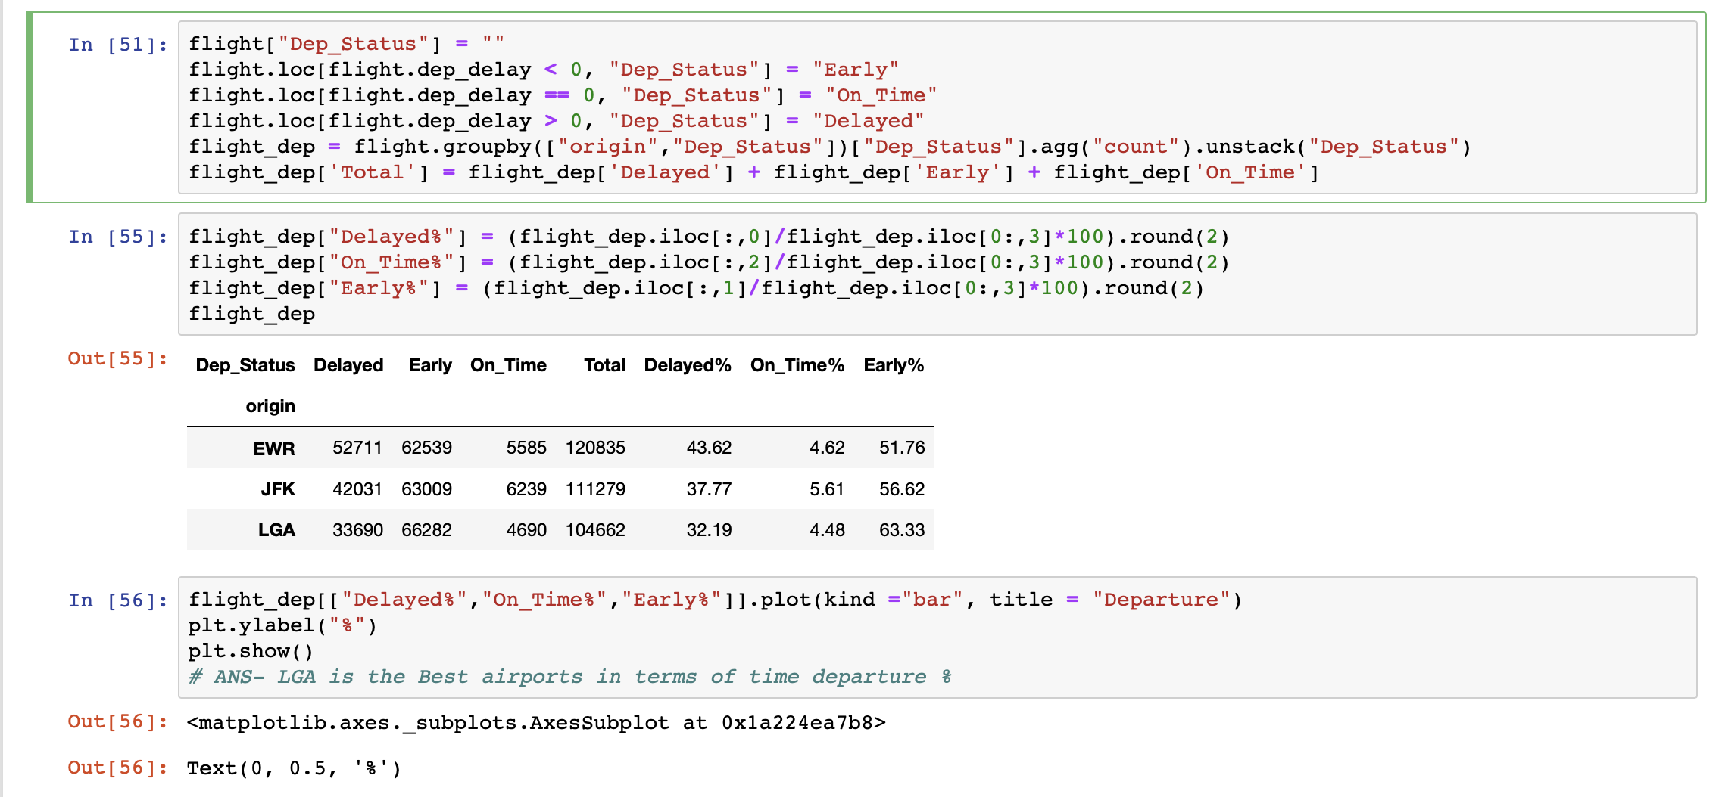
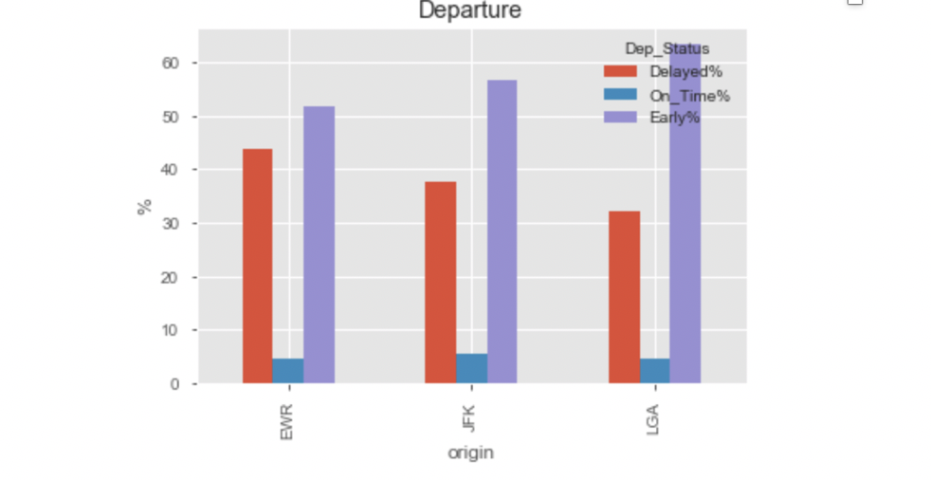

Q4 -Best airports in terms of time departure %
Findings & Visualizations

Slide 19
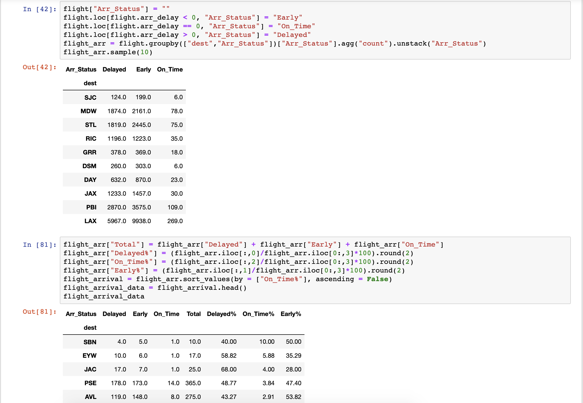
Q5- On time arrival % analysis
Findings & Visualizations

Slide 20
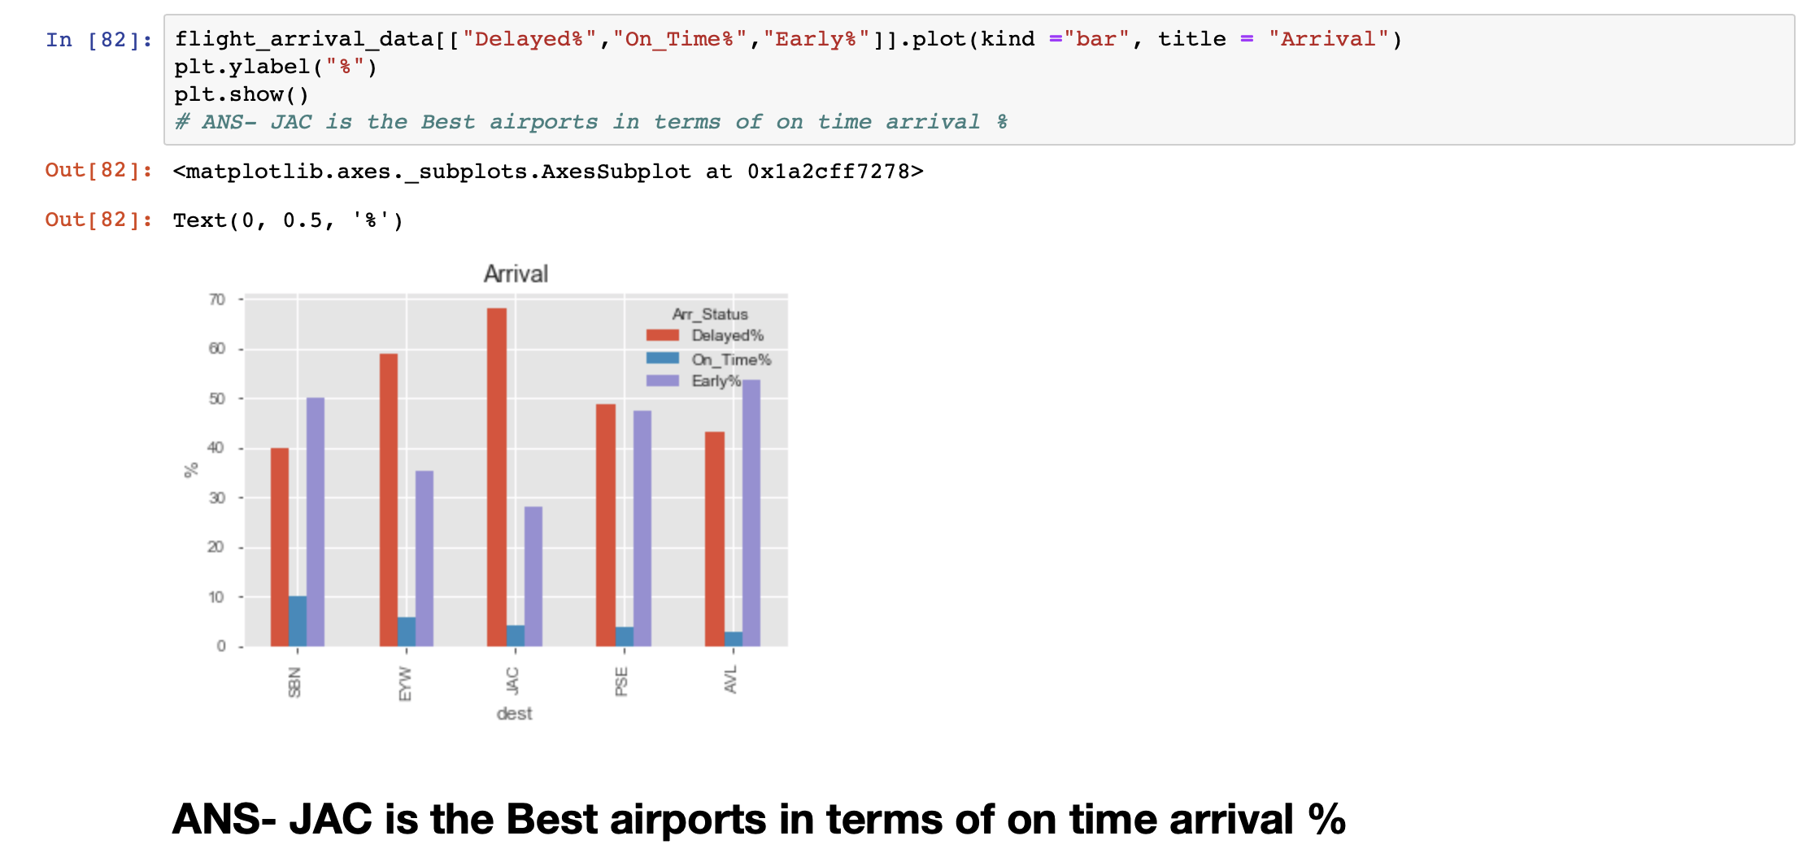
Findings & Visualizations

Slide 21
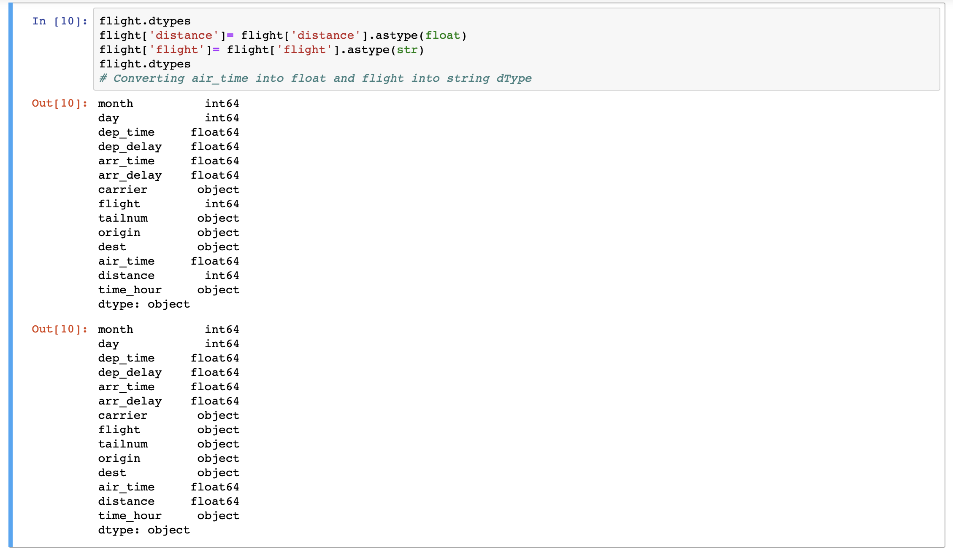
Q6 -Aircraft speed analysis.
Approach

Slide 22
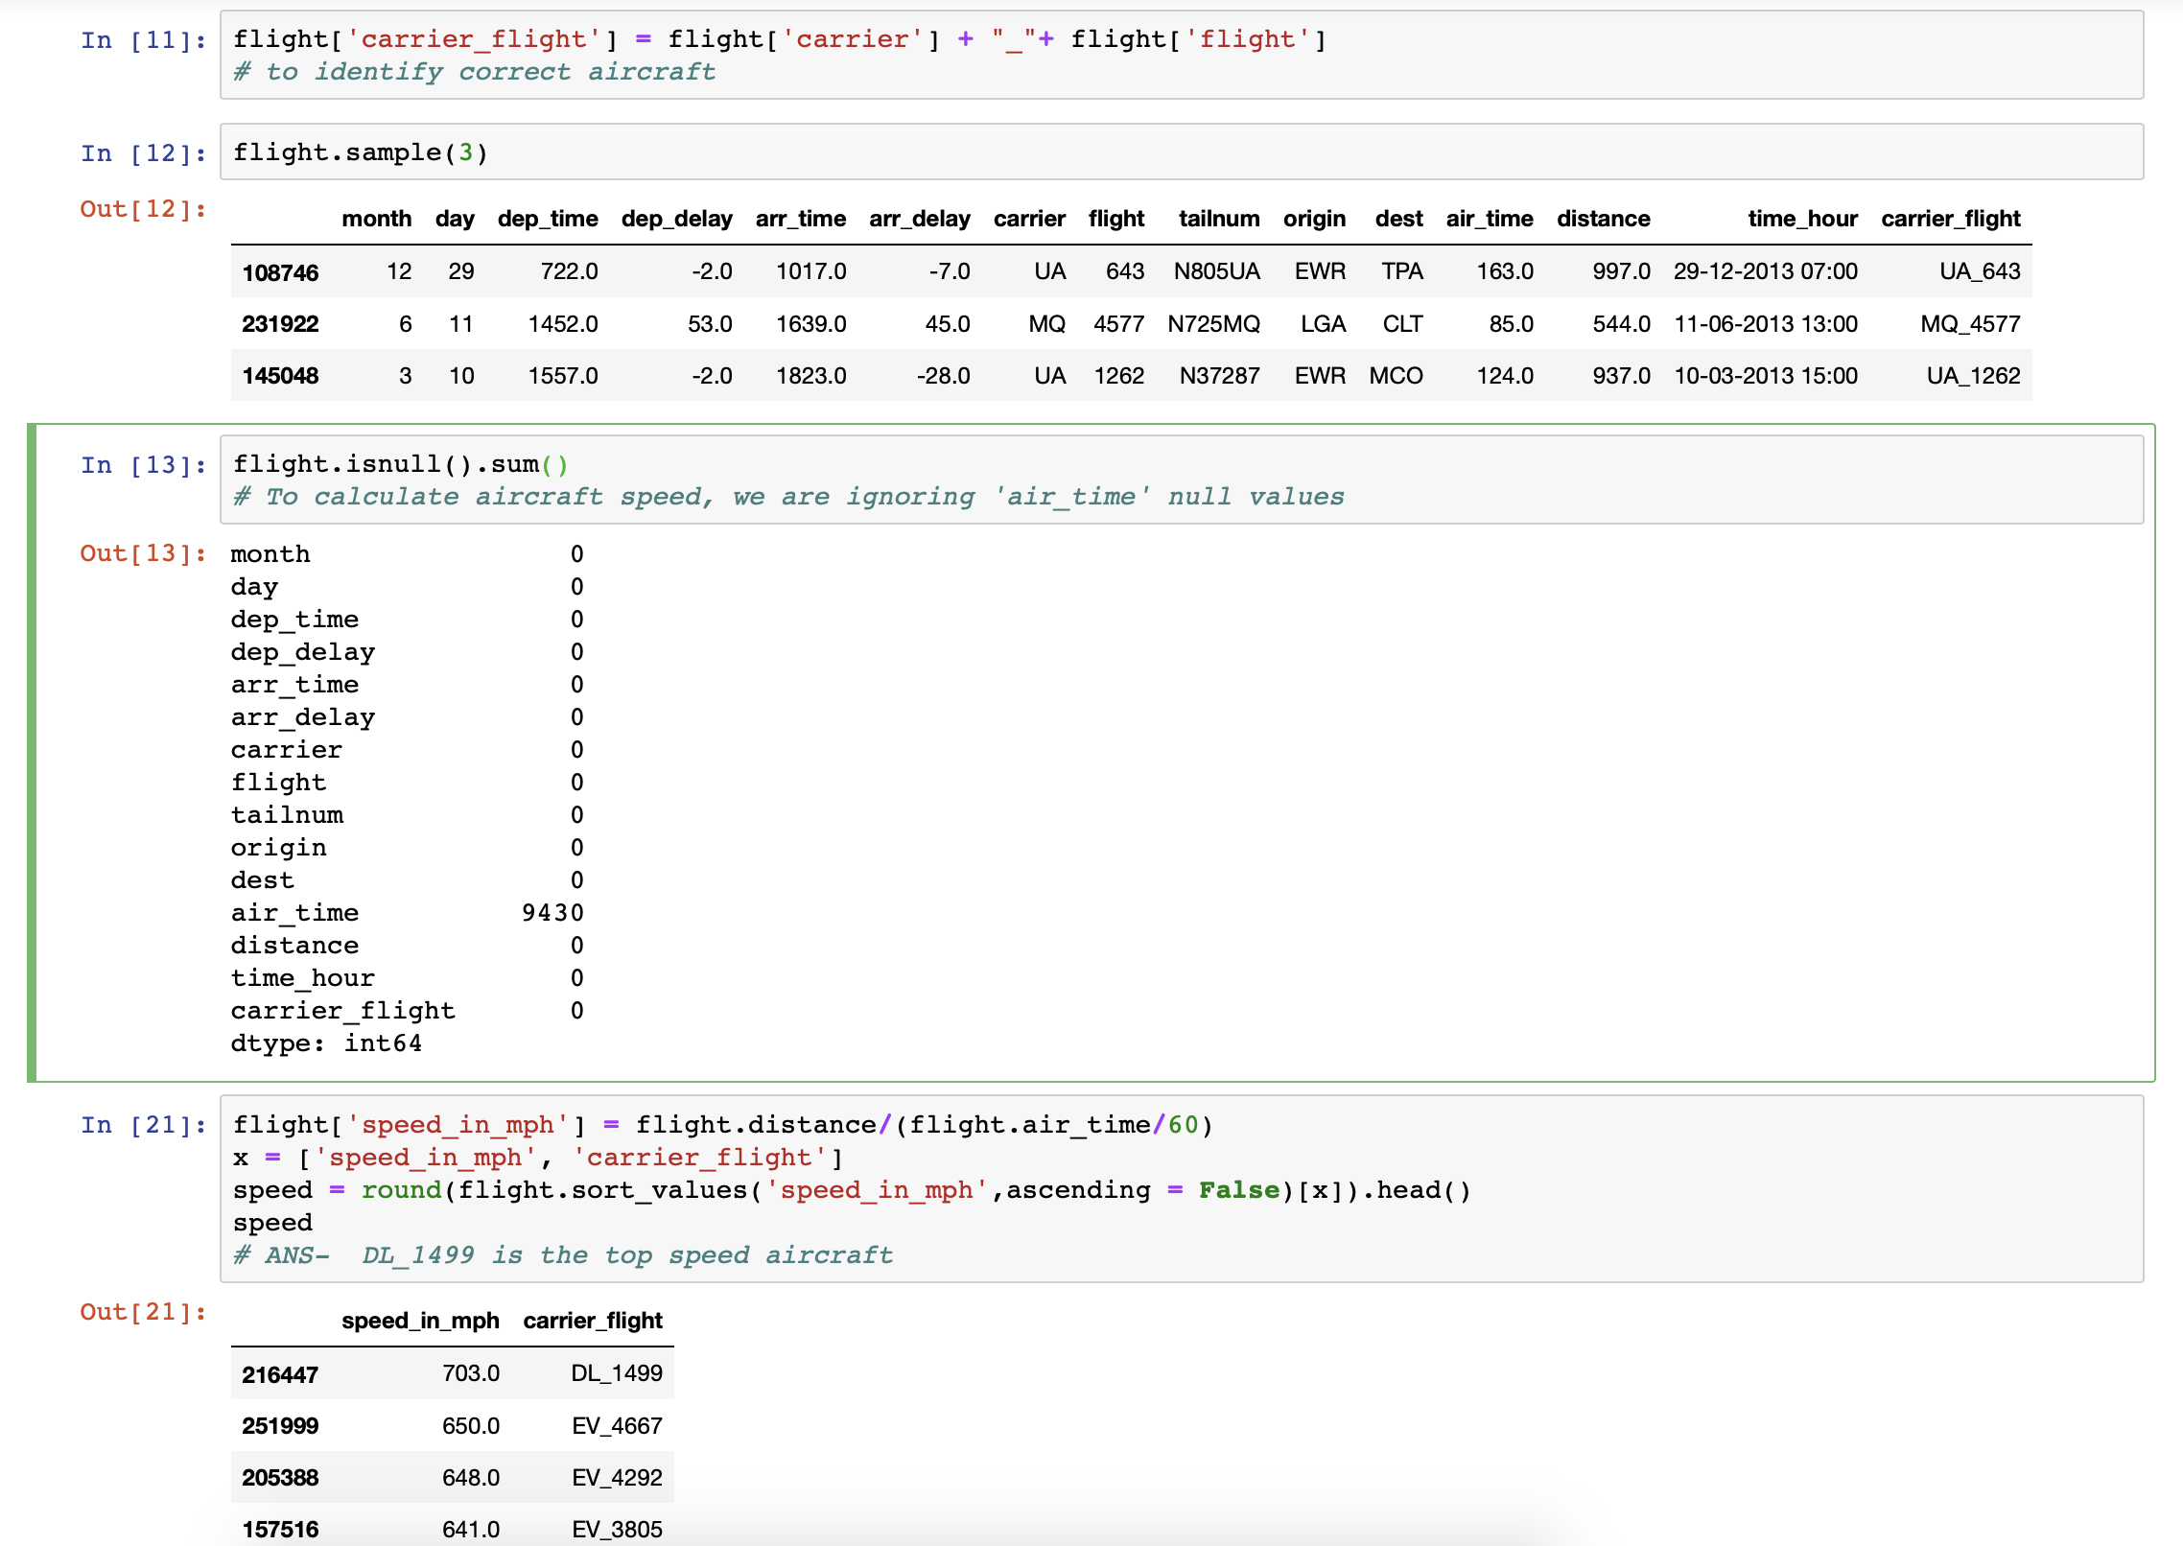
Approach

Slide 23
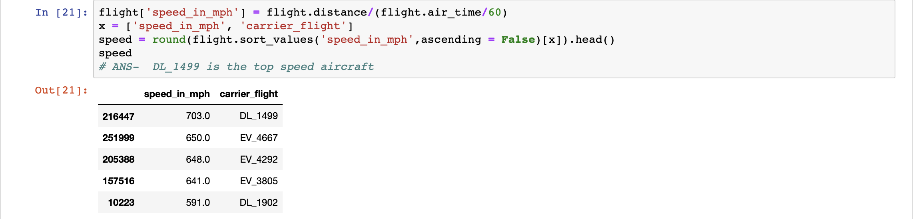
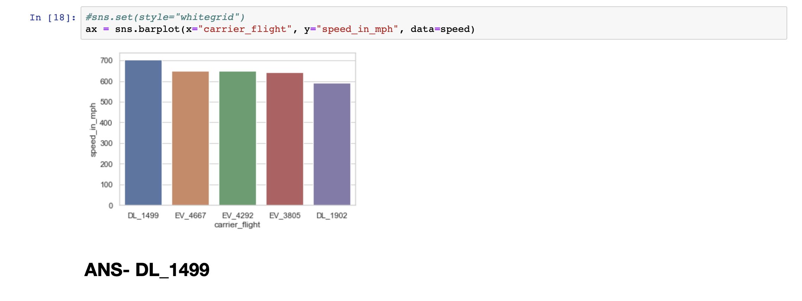
Findings & Visualizations

Slide 24
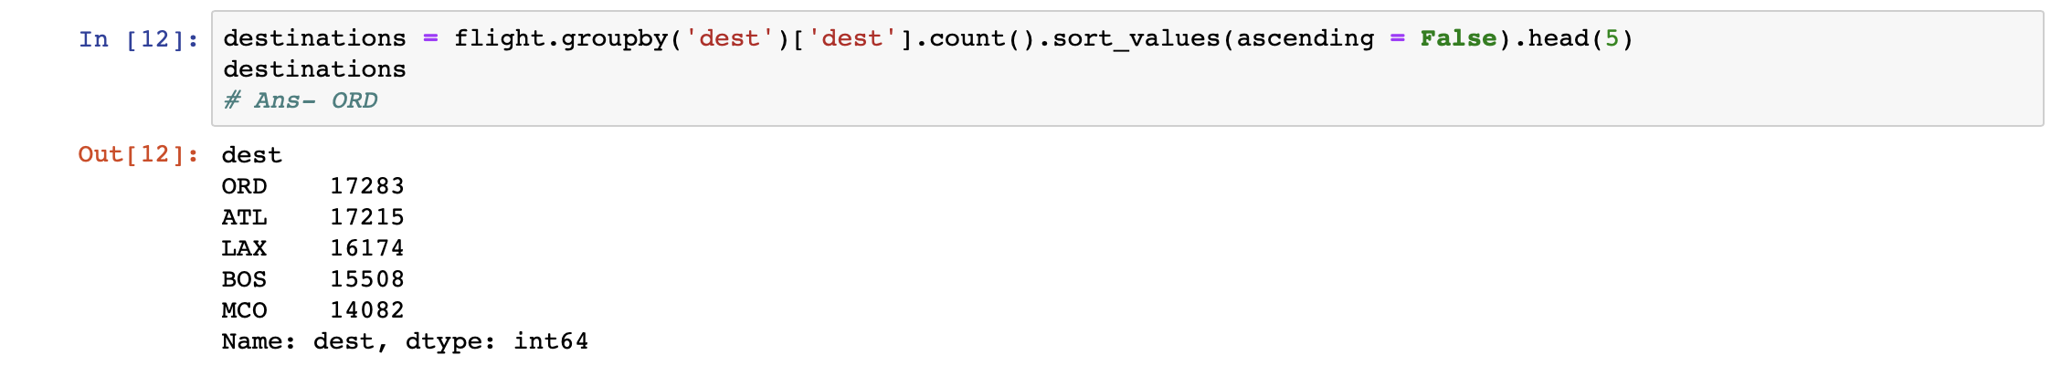
Q7- Maximum number of flights headed to some particular destination.
Findings & Visualizations

Slide 25
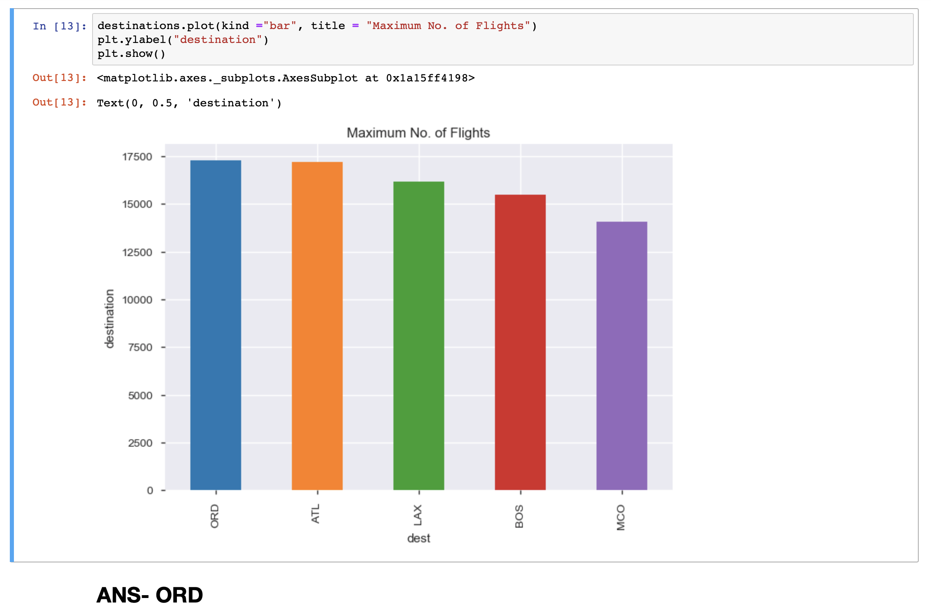
Findings & Visualizations

Slide 26
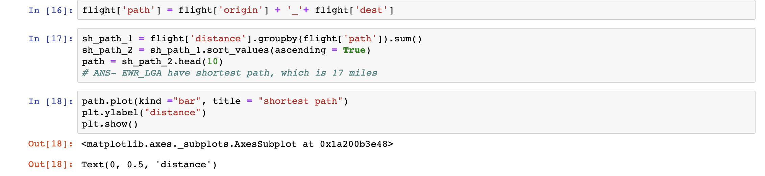
Q8- shortest path
Findings & Visualizations

Slide 27
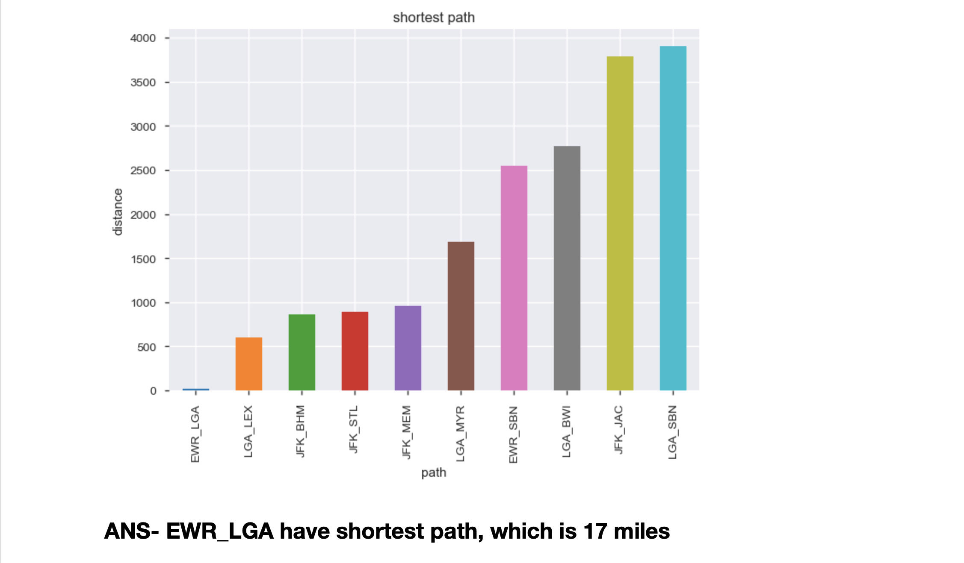
Findings & Visualizations

Slide 28
Thank You

